Slide 1

Exploring Global Climate Change
Bella Primus, Chiara Adjoh-Davoh, Keon K., Olivia Lastique, Shreeya Gautam, Halia Benn

Slide 2
TABLE OF CONTENTS
01
02
03
04
05
06
Data Selection
Data Wrangling
Visualization 1
Visualization 2
Visualization 3
Summary Analysis

Slide 3
OUR SOURCE
Dataset from Kaggle: Global Temperature Data by Adil Shamim
THE GOAL: To visualize and uncover patterns in climate change and variability across different countries between the years 2000 and 2024
TEN COLUMNS:
Year | Country | Average Temperature | CO2 Emissions per capita | Sea Level Rise
Rainfall | Population | Renewable Energy | Extreme Weather Events | Forest Area
Data Selection

Slide 4
Data Cleanup
The dataset did not have any empty or null rows, so those did not have to be addressed.
However, some countries had multiple rows for the same year, which can be quite confusing. For example, South Africa had 7 entries in the year of 2000. With no month being listed, it can be hard to tell which should be used. To make it easier and only allow one row per country per year, we grouped by Year and Country (which automatically arranges the data from oldest to most recent for easier visual clarity), and then aggregated the data, using mean and max when appropriate.
It should be noted that after this consolidation, there were still some countries that did not have data at all for some years. The significance of the amount of data collected is discussed in a later slide.
Data Wrangling

Slide 5
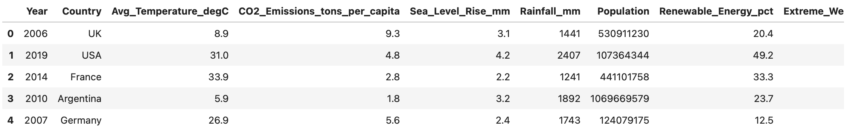
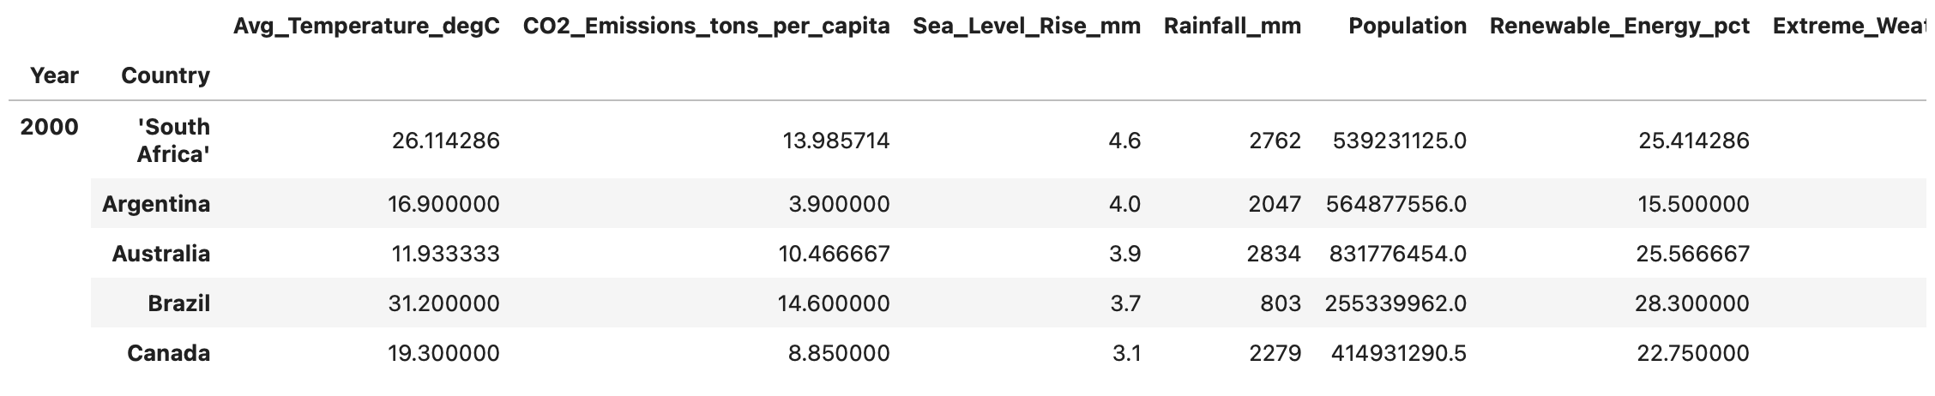
Data Cleanup
Before
After
Data Wrangling

Slide 6
Feature Engineering
Next, we added features for accessibility.
Abv_Avg_Events: Returns 0 or 1 depending on if the data point has more or less than the median number of Extreme_Weather_Events, to show which years/countries had more than normal extreme events.
Climate: A categorical variable that is either "Warm", "Temperate", or "Cold" depending on the average temperature for the year & country.
Data Wrangling

Slide 7
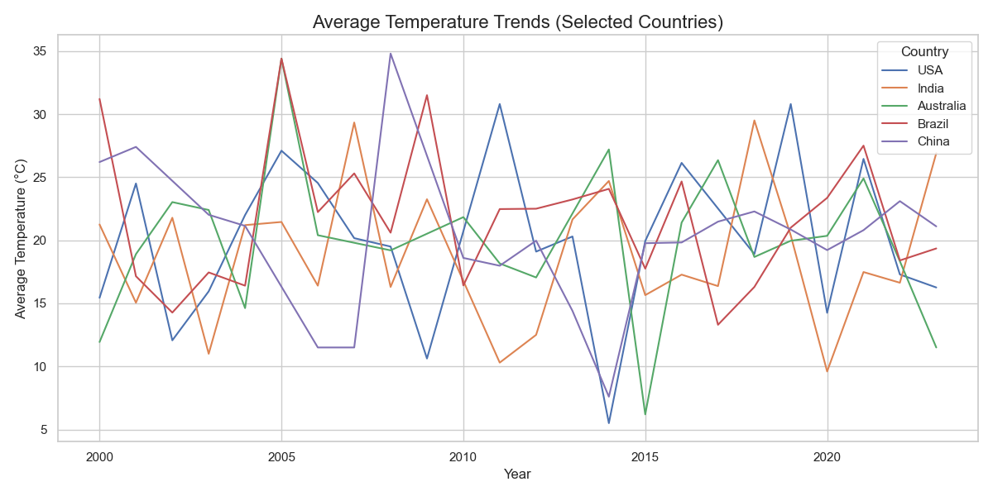
03
Visualization 1
Average Temperature Trends by Country (2000–2024)

Slide 8

TAKEAWAYS:
3. Raw Data Effects: The data highlights short-term changes but can obscure long-term trends.
1. High Variability:​ Pronounced year-to-year temperature changes , especially in the USA and India
2. China Appears More Stable:​ China’s steadier trend may reflect consistent climate conditions or standardized data collection.

Slide 9
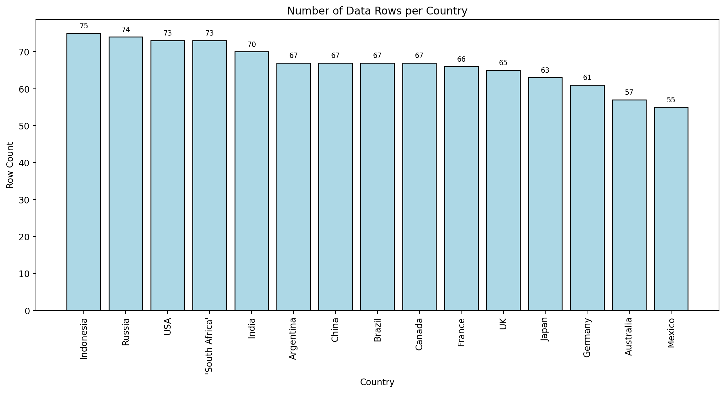
Visualization 2
Number of Data Rows per Country in the Data Set

Slide 10
Number of Data Rows per Country in the Data Set
Key Takeaways:
The Country that was top contributor of data was Indonesia, which likely means they have the most consistent environmental data.
There is bias in some of the findings within our data set due to countries with more data dominating the patterns.
The countries with more rows have better environmental monitoring.
This visualization was created using the dataset before the aggregation of rows. It helps to show the bias in the data that can be caused by each country submitting a vastly different amount of data.

Slide 11
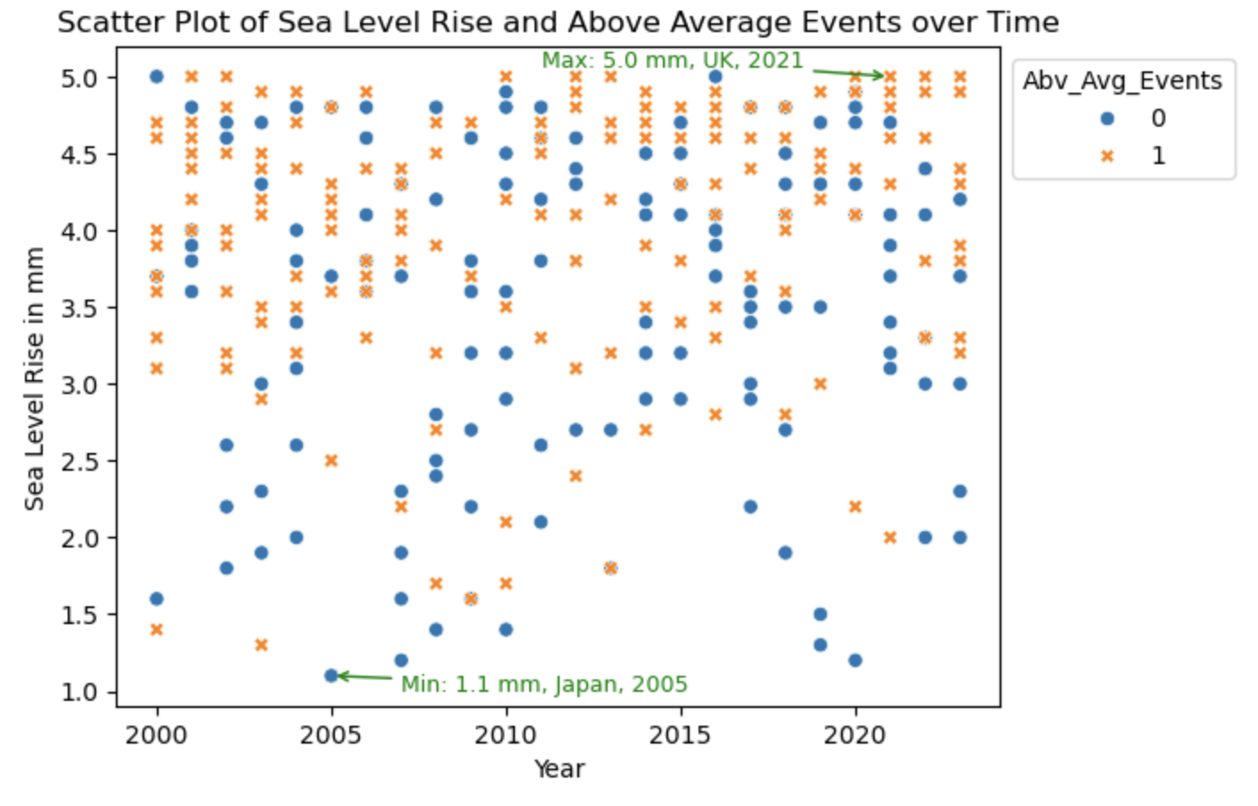
Visualization 3
Scatter Plot of Sea Level Rise and Above Average Events over Time

Slide 12
Visualization 3
Key Takeaways:
As time goes on, the data pushes upward, meaning that the more recent the year, the higher the sea level rise.
Our Above Average Events variable, with 1 representing a data point that is above the average, comprises most of the upper half, with sparse outliers in the bottom half.
Data points where the average number of extreme events is below average tend to have lower levels of sea level rise.
All but 2 of our maximum values, of which there are many, have an above average amount of extreme events. The inverse is true for our minimum values.

Slide 13
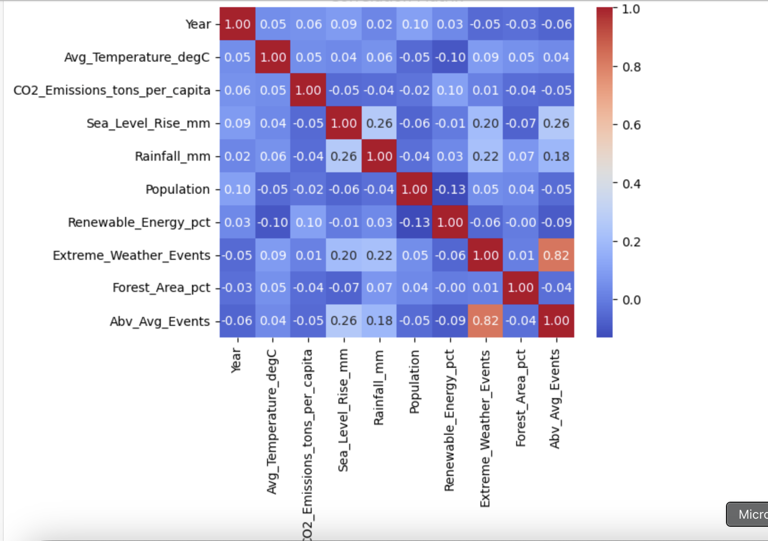
Correlation Matrix

Slide 14
Correlation Matrix
Disregarding the correlation between Abv_Avg_Events and Extreme_Weather_Events, since one is modeled after the other, some variables that are correlated include:
Sea Level Rise and Rainfall
Sea Level Rise and Year
Sea Level Rise and Extreme Weather Events / Above Avg Events
Rainfall and Extreme Weather Events
Average Temperature and Renewable Energy Percentage (Inversely Correlated)
Population and Renewable Energy Percentage (Inversely Correlated)

Slide 15
Key Takeaways
This dataset is most useful in comparison between countries for certain factors
The dataset can also be used to compare data from a single country across time
There is some bias in the dataset, based on data entries per country
Climate change factors are not very dependent on each other, but collectively produce an effect on the environmental reality of our globe
Correlation between factors is usually more of an indirect effect
(ex. Rainfall and Sea Level Rise)
Summary Analysis

Slide 16
Thank You
We hope to have given you a better understanding of global climate change !

